Slide 2
Capital Expenses:
From Software to Shipping & Fabrications to Facilities
Cha Ying Lor
Finance Associate Director
Property Accounting
Zach Smith
Research Administration Manager
Department of Mechanical Engineering
Notes:
Zach

Slide 3
Session Outline
Capital Expenses
Capital Assets
Cost Threshold
Capitalizable Costs
Non-Capitalizable Costs
Budgeting Considerations
Terms and Conditions
Titling and Disposition
Notes:
Zach

Slide 4
Learning Objectives
Clearly identify capitalized equipment
Be able to more effectively budget
Know what questions around seemingly “non-equipment” equipment should be asked
Better navigate terms and conditions
Become more familiar with UW resources on capital equipment
Notes:
Zach

Slide 5
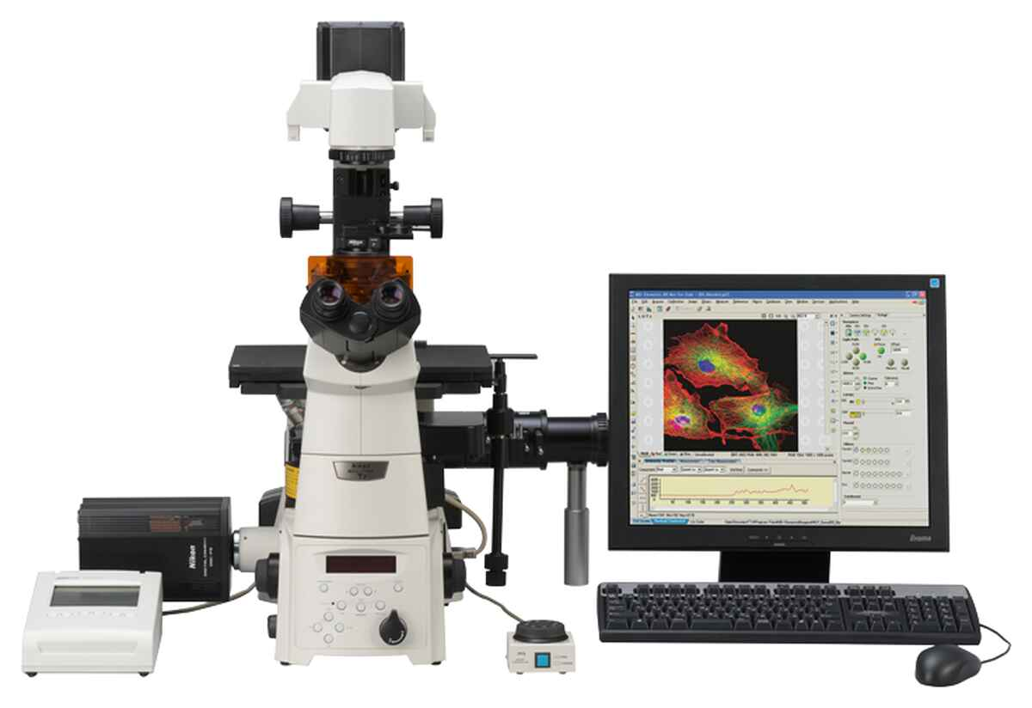

Let’s buy a fancy microscope!
Ooooh, so fancy and only $150K
Notes:
Zach

Slide 6
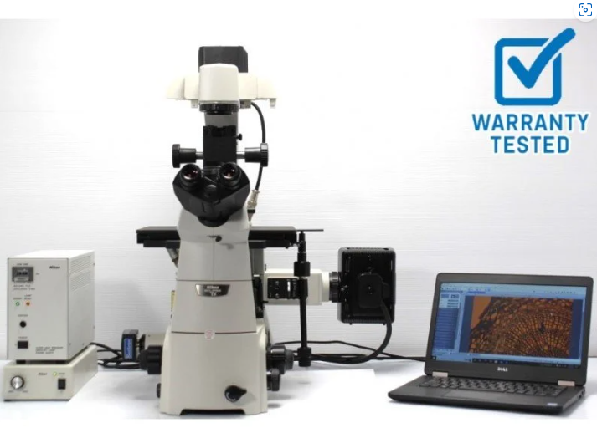

Gotta get rid of this antique first…
Look at that screen and how small it is.
Who uses knobs anymore anyway?
Must…get…new…one…
Value of Trade-in - $9,895
Notes:
Zach

Slide 7

Mmmm. Nikon Eclipse Ti2-E
Nikon Eclipse Ti2-E Inverted Microscope
- $150,000
Notes:
Zach

Slide 8

But wait, we need something to run it…
Computer - $1,500
Software - $4,000
Notes:
Zach

Slide 9

Oh, and I need other controllers too???
Environmental Controller - $7,000
Notes:
Zach

Slide 10

What, installation?
System Installation - $6,200
Notes:
Zach

Slide 11

Seriously, we need training by Nikon staff?
Training Costs - $3,000
Notes:
Zach

Slide 12

And maintenance is required for warranty?
Annual Maintenance - $5,000
Notes:
Zach

Slide 13

Free, Prime shipping???? From Japan???
Shipping Costs - $2,000
Insurance - $1,000
Customs Charges - $2,000
Notes:
Zach

Slide 14

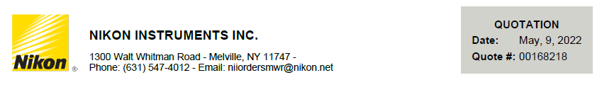
Okay, okay, how much?
- Microscope - $150,000
- Computer - $1,500
- Software - $4,000
- Environmental Controller - $7,000
- System Installation - $6,200
- Training Costs - $3,000
- Shipping, Customs & Insurance - $5,000
- Annual Maintenance (3 yrs) - $15,000
- Trade-in ($9,875)
Total - $181,825
Notes:
Zach

Slide 15
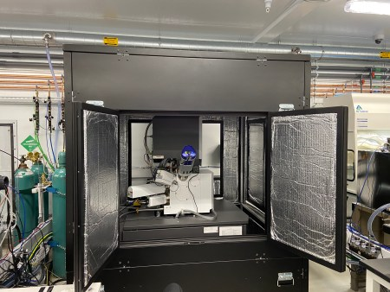
Wait…it has to be in an acoustic enclosure…
SEM Acoustic Enclosure - $28,200
Notes:
Zach

Slide 16
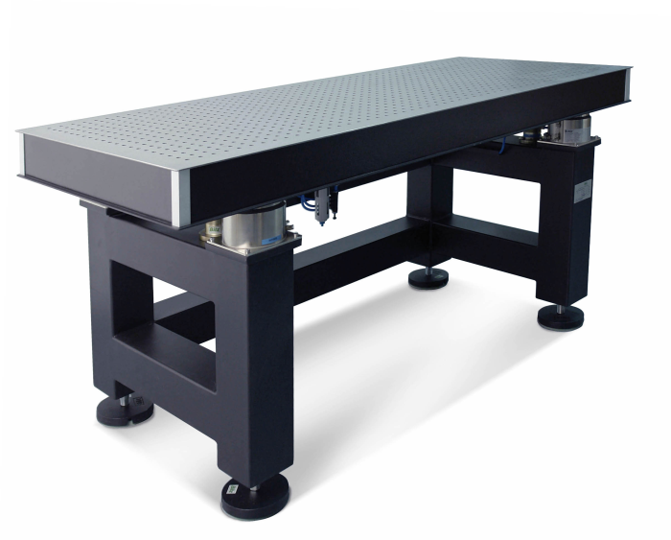
and the anti vibration table isn’t included…
Active vibration isolation table
- $10,625
Notes:
Zach

Slide 17
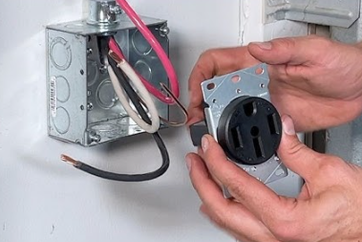
and we need a new outlet and breaker….
FP&M Costs for new electrical outlet and breaker - $3,500
Notes:
Zach

Slide 18
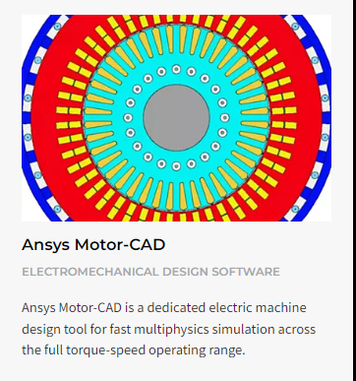
and my students need software licenses….
Annual license tokens - $2,000/student
Notes:
Zach

Slide 19

Okay, where are we now?
Nikon System - $181,825
Acoustic Enclosure - $28,200
Table - $10,650
FP&M - $3,500
Software Licenses - $18,000
Total = $242,175
Notes:
Zach

Slide 20
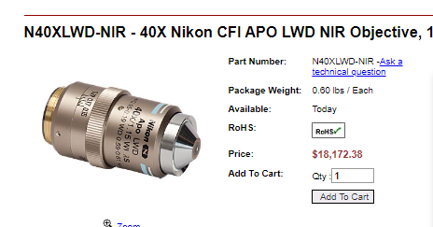

But what about that specialized objective we’ll need for Aim 5 in year 3?
Upgraded Objective - $18,172.38
Notes:
Zach

Slide 21

And the reagents, gases, pipets…
Consumables - $5,000/yr???
Notes:
Zach

Slide 22


I thought we were just buying a microscope…
Nikon System - $181,825
Enclosure - $28,200
FP&M - $3,500
Specialized Objective
- $18,172.38
Table - $10,625
Software Licenses
- $18,000
Consumables - $15,000
Notes:
Zach

Slide 23



I thought we were just buying a microscope…
$150,000 turned into $275,000+
Notes:
Zach

Slide 24
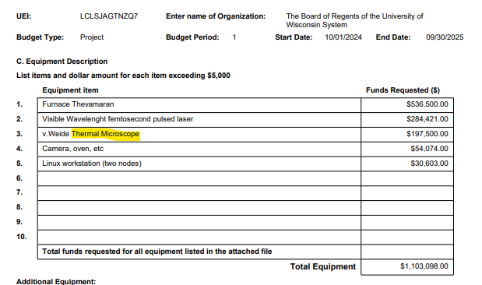

Uh, oh…we budgeted for this, right?
Is thermal the same as inverted?????????
Notes:
Zach

Slide 25
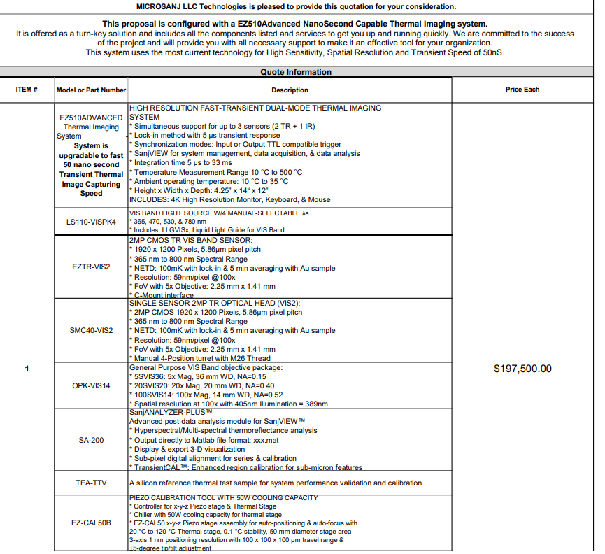

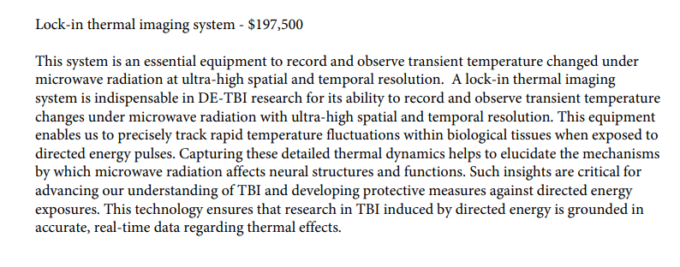
Let’s look further into the budget justification…
Notes:
Zach

Slide 26

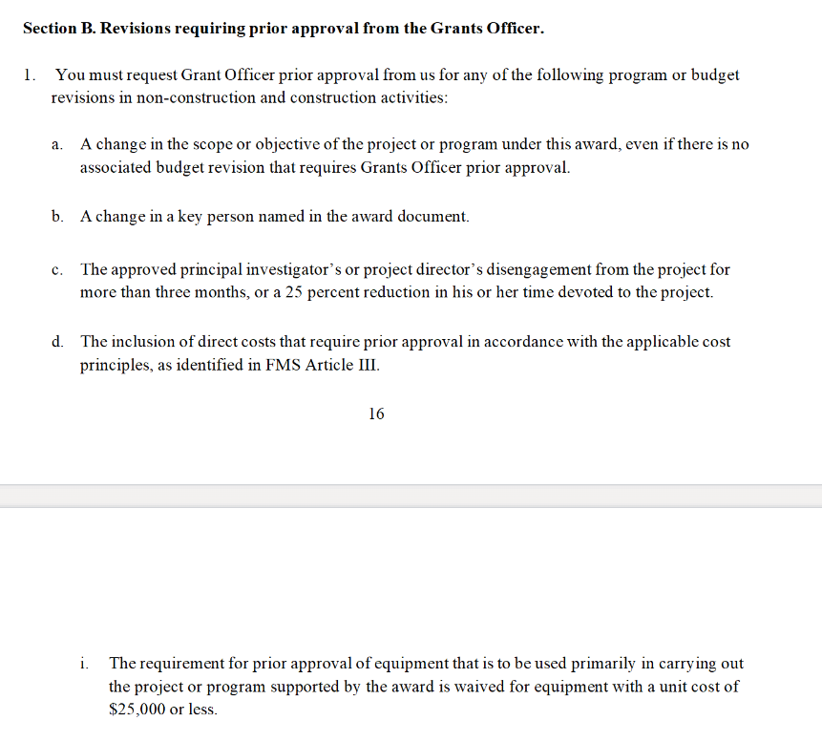
NOOOOO. They aren’t the same
Can we still buy it???? What do the Terms and Conditions say???
Notes:
Zach

Slide 27


Takeaways from the Example
Consider all costs
Determine which will be capitalized expenses
Understand what is allowable
We need to budget appropriately
Notes:
Zach

Slide 28
Capital Expenses – what are they?
1) Expenditures for the acquisition of capital assets
2) Expenditures for additions, improvements, modifications, replacements, rearrangements, reinstallations, renovations, or alterations to capital assets that materially increase their efficiency or functionality and useful life.
Notes:
Cha

Slide 29
What makes something a Capital Asset?
Cost Threshold
Must be at least $5,000*
Useful Life
Useful life expectancy must be at least 1 year or more
Standalone – Moveable
The item cannot be permanently affixed to a building or another object in such a way as to lose its unique identity
*will change to $10,000 whenever UW negotiates new F&A rate
Notes:
Cha

Slide 30
Other costs able to be capitalized
Associated Costs of receiving a capital asset and placing it into service may be allowed to be capitalized, including:
Freight Costs
In-transit Insurance
Customs Charges
Installation and Setup
Training
Value received form trade-in of an existing asset
Notes:
Cha

Slide 31
Cost Threshold - Information
Cost Threshold at UW is currently* $5,000
Must have a per-unit acquisition cost of >= $5,000 or
Must have a combined fabricated cost of >= $5,000
  This means $0.50 bolts could/should be capitalized if part of a fabrication > $5,000
*OMB now lists $10,000 but UW is still following its negotiated F&A rate definitions
Notes:
Cha

Slide 32
Notes about Fabricated Equipment
Fabrications are capitalized if they meet the same standards as a capital asset – cost, useful life, moveable.
Fabrications are:
  Custom joined component parts and direct labor creations
  Commercially not available
  All components must work together
    Each part must be necessary for asset to function
  Software can be part of fabrication if it will not function without it
Fabrications receive one asset ID
Notes:
Cha

Slide 33
Notes about Child Assets
Child Assets are add-ons to (completed) assets – “Parent”
They must meet the same standards as a capital asset – cost, useful life, moveable.
In our example:
Specialized Objective
- $18,172.38
Notes:
Cha

Slide 34
Costs that Cannot be Capitalized
Consumables
  Even if a single cost is > $5,000 for the consumable
  Even if the items are used with the capitalized equipment
    Pipets, slides, chemicals, gases, fuels or similar supporting supplies
Immoveable Items
  Items either permanently installed or affixed to a building
    Sinks, outlets, fume hoods, buried fuel tanks or similar items.
Upgrades, additions and/or modifications < $5,000
  Even if these materially increase an assets value or useful life
Notes:
Cha

Slide 35
Other Costs that Cannot be Capitalized
Associated Costs with Capital Equipment
Warranties
Maintenance
Service Plans
Replacement Parts
Spare Parts
Repair costs
Notes:
Cha

Slide 36
Which expenses are capitalized?
- Microscope - $150,000
- Computer - $1,500
- Software - $4,000
- Environmental Controller - $7,000
- System Installation - $6,200
- Training Costs - $3,000
- Shipping, Customs & Insurance - $5,000
- Annual Maintenance (3 yrs) - $15,000
- Trade-in ($9,875)
Total - $181,825
Notes:
Cha/Zach

Slide 37
Which expenses are capitalized?
Nikon System - $181,825
Enclosure - $28,200
FP&M - $3,500
Specialized Objective
- $18,172.38
Table - $10,625
Software Licenses
- $18,000
Consumables - $15,000
Notes:
Cha/Zach

Slide 38
Capital Expenses in our Scenario
Equipment – Microscope, Anti-Vibration Table
Trade-in Value of an existing asset – old microscope
Freight, Insurance and Customs Costs
Installation and Setup
Training
Software ???
Additions >= $5,000 that add value and/or useable life to asset - lens
Notes:
Cha/Zach

Slide 39
Costs unable to be Capitalized in our Scenario?
Maintenance Plan
FP&M Costs
Consumables
Notes:
Cha/Zach

Slide 40
Pre-Award Budgeting Considerations
Communication
  Talk with your PI! Understand the full plan and implications
  Identify any required facility upgrades (get FP&M quotes)
  Explore all peripheral costs
Budget Correctly
  Ensure capital expenses are exempt from F&A
  Provide quotes
Unallowable Costs
  Identify any costs that are required for the equipment would be unallowable on the grant
Notes:
Zach

Slide 41
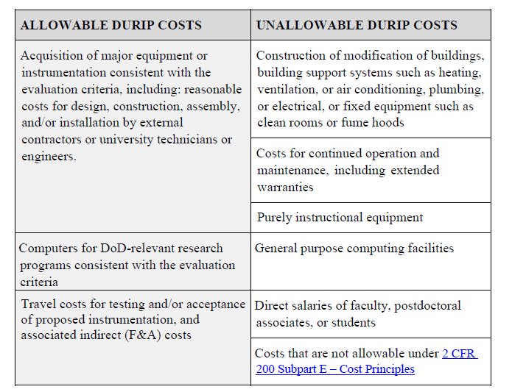
Allowable Costs - NOFO
Notes:
Zach

Slide 42
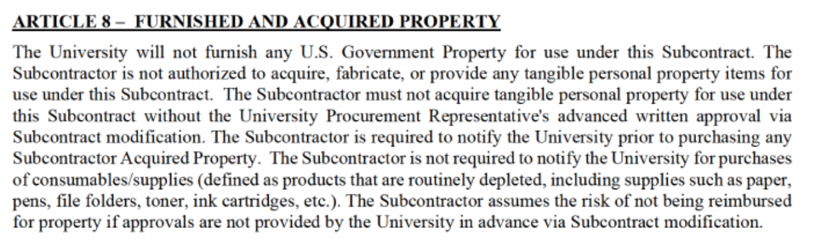
Terms and Conditions – NO Equipment
Notes:
Zach

Slide 43
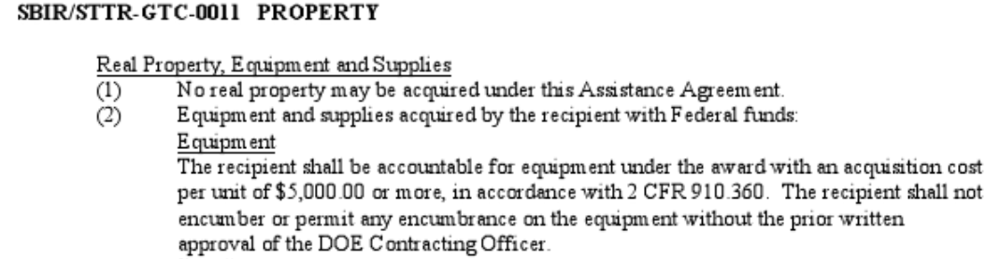
Terms and Conditions – Prior Approval Required
Notes:
Zach

Slide 44
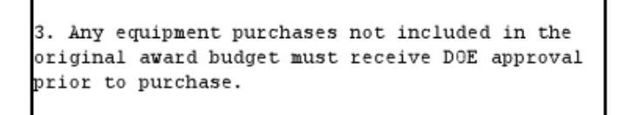
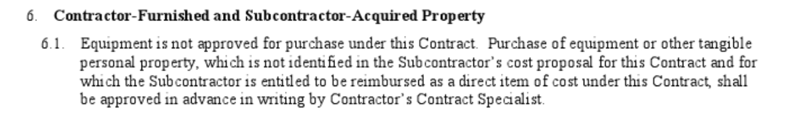
Terms and Conditions – Prior Approval Required
Notes:
Zach

Slide 45
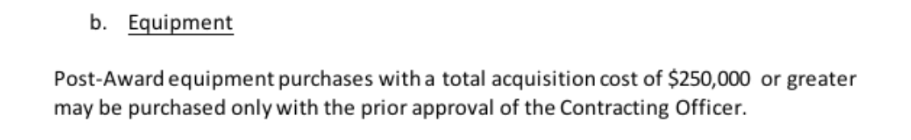
Terms and Conditions - Other
Notes:
Zach

Slide 46
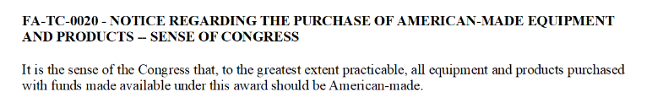
Terms and Conditions – Buy America
Notes:
Zach

Slide 47
Titling - Considerations
Sponsor Conditions
  Sponsor may allow title to rest with UW, but equipment only be used on sponsored projects funded by that sponsor
Trade in Restrictions
Notes:
Cha

Slide 48
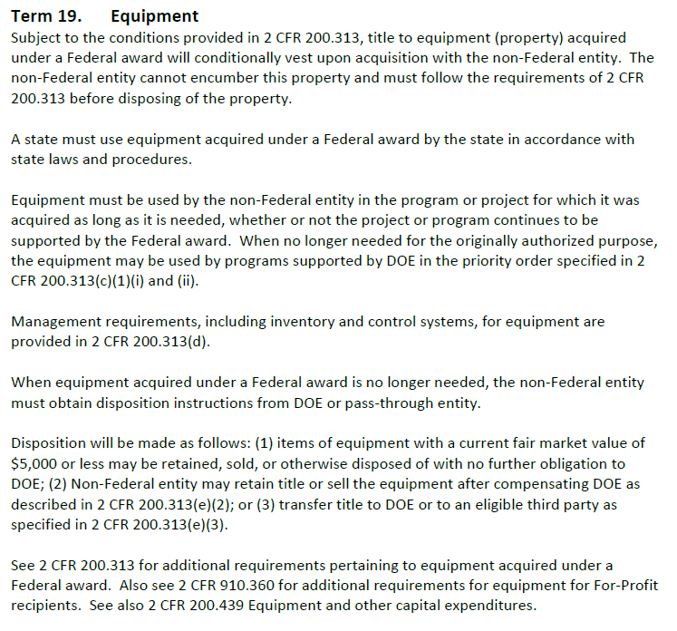
Disposition
Notes:
Cha

Slide 49

Questions

Slide 50
Resources – UW Business Services
Capital Equipment
https://businessservices.wisc.edu/accounting/capital-equipment/
Definitions
https://businessservices.wisc.edu/wp-content/uploads/sites/546/2018/11/Capital-Equipment-Definitions.pdf
Policy – Capital Equipment
https://policy.wisc.edu/library/UW-3008
Procedure – Fabricated Capital Equipment
https://businessservices.wisc.edu/documents/3008-4-fabricated-capital-equipment-procedure/
Procedure – Upgrades to Existing Capital Equipment https://businessservices.wisc.edu/documents/3008-5-upgrades-to-existing-capital-equipment-procedure/
Notes:
Cha

